Slide 1
Professional Financial Reports with {rmarkdown}
Brad Lindblad, MBA
bradley.lindblad@gmail.com
Technistema.com
Repo:
https://github.com/bradlindblad/pro_reports_talk

Slide 2




Key players

Slide 3
Disclaimers:
Rmarkdown / pandoc / TeX can cause pain
Use {renv} : > renv::restore()
Tested on:
Windows 10 (easiest)
Linux Mint 20 (may need to install magick++ with apt
Mac OS

Slide 4
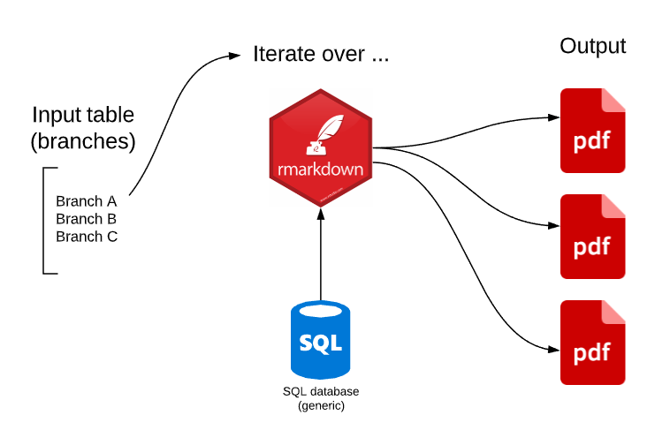

Slide 5


Slide 6
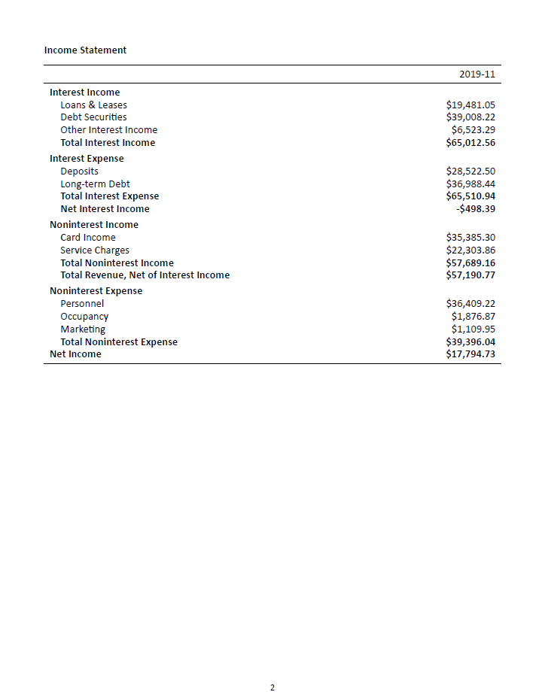

Slide 7
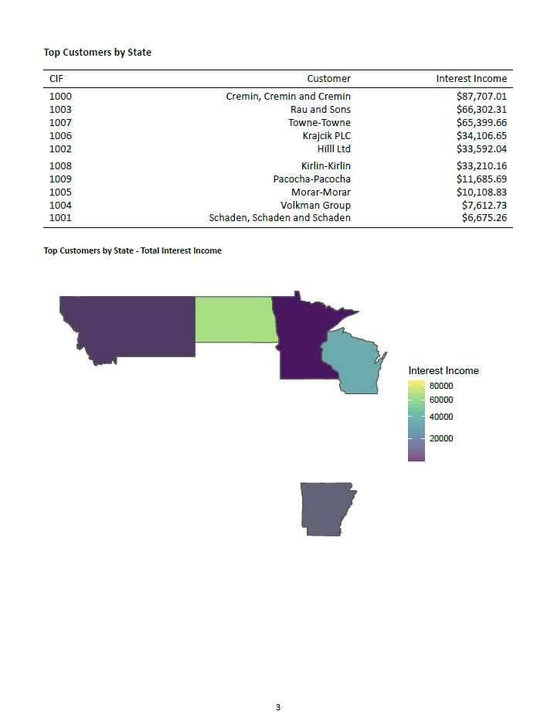

Slide 8
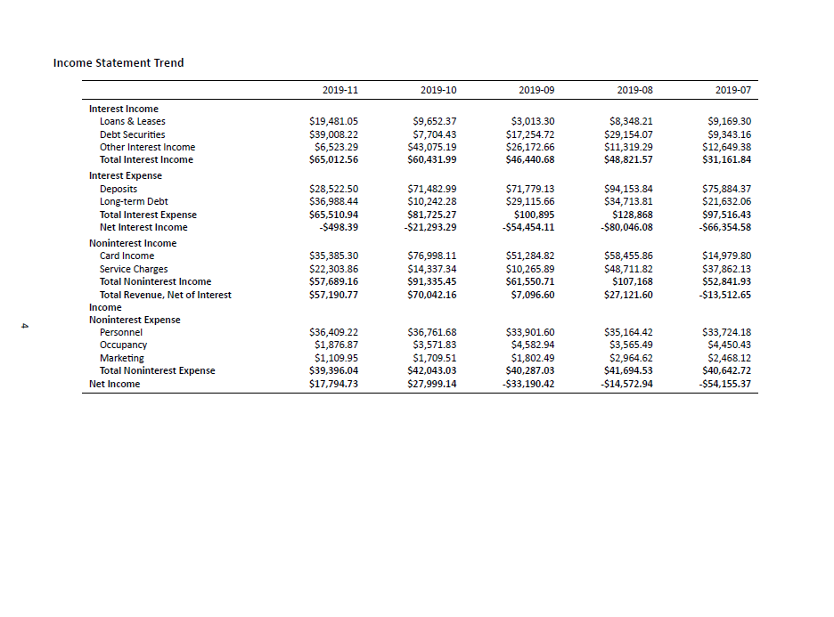

Slide 10
Use it:
Use my example repo to:
Pick off Excel reports
Make your own reporting easier
Automate the boring and error-prone stuff

